Slide 1



Daily Typing Do-Now
Open typing.com
Log into your account
Complete a 1 minute typing test
With the remaining 4 minutes
Work on a typing lesson
Play a typing game
Complete more typing tests

Slide 2
Early AI
1770 - 1988
Intro to Computer Science

Slide 3

Schedule
Week 13
Thursdays - Early AI (1770 - 1988)
Friday - Early Neural Networks (1957 - 2011)
Week 14
Monday - Neural Networks Structures
Tuesday - Language Modeling
Wednesday - LLMs
Thursday - Neural Network Coding
Friday - Modify Classifier Project

Slide 4
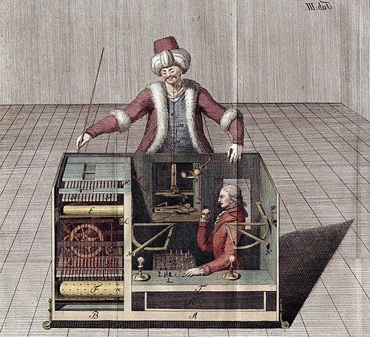
The Mechanical Turk (1770 - 1854)
The mechanical turk was a chess playing “machine” created in 1770
The machine was a sensation touring the Europe & the US
The machine was a scam with a chess grandmaster sitting hiding under the machine

Slide 5
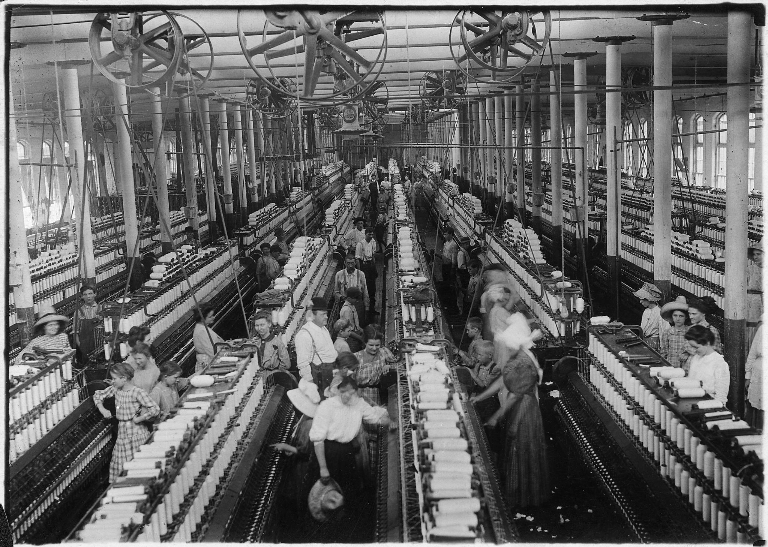
The Industrial Revolution
Beginning in the late 1700s and accelerating through the 1800s the industrial revolution completely reorganized society.
Machines began to automate tasks that were originally performed by humans. Those who owned the machinery to perform automation became massively wealthy

Slide 6
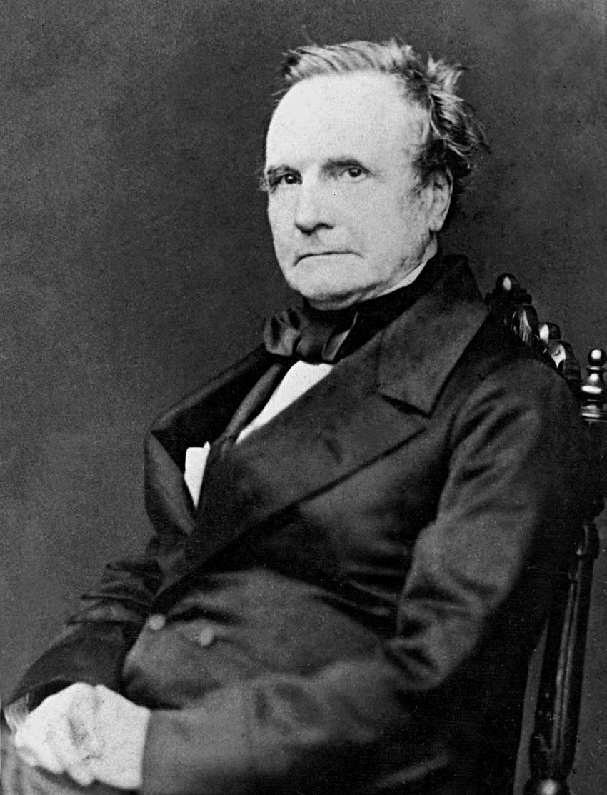
Charles Babbage's Difference Engines
Lived from 1791 - 1871.
Designed a machine called the difference engine in 1822 to calculate polynomial functions.
The idea was to automate the work of astronomers in calculating mathematical tables.
The designs were never completed in his time.

Slide 7
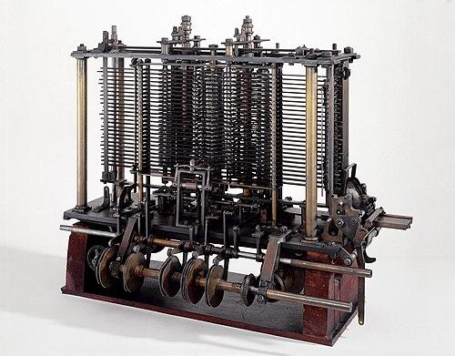
Charles Babbage's Analytical Engine
After the difference engine fell through, Babbage, designed a new machine in 1837.
The goal of the Analytical engine was to further automate tasks requiring human intelligence like computation.
The design was supposed to be the first programmable computing machine.
Mathematician Ada Lovelace wrote programs for this machine, making her the first programmer.

Slide 8
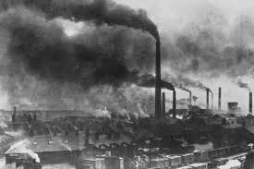
Babbage on Intelligence & Automation
Babbage's goals were to use his machines to apply the factory system to intelligent tasks.
Babbage was a proponent of production by breaking down tasks into smaller more specific tasks, the division of labor.
Babbage used the term machine intelligence.

Slide 9
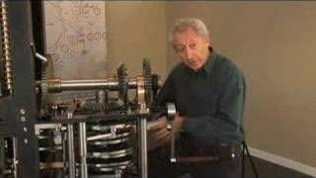
Babbage's Engine Example

Slide 10
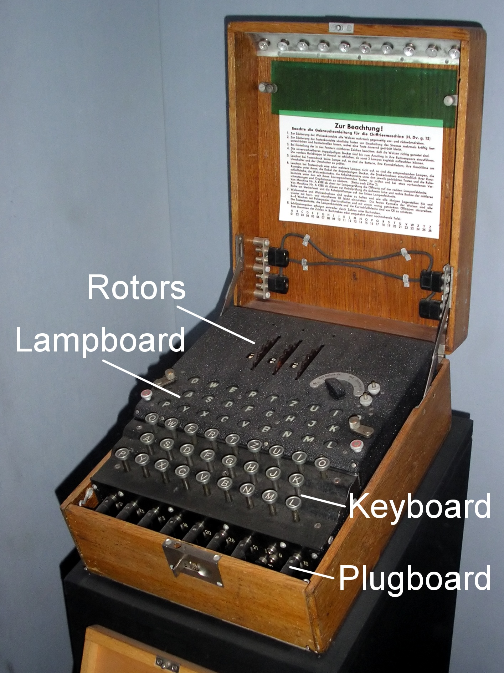
Alan Turing & The Bombe (1941)
The next breakthrough in computing occurred during World War II.
The Nazis were using a machine called The Enigma to encode their messages to each other.
Alan Turing was a mathematician who worked to develop a codebreaking machine called The Bombe to decode the enigma messages.
This gave the allies a massive advantage, saving countless livees.

Slide 11

Imitation Game Clip

Slide 12
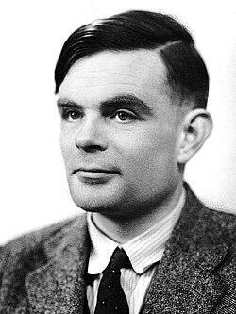
The Turing Test
After WW2 Turing produced significant research on AI
Turing explored machines capable of completing tasks like Chess and translation
Turing proposed the idea that machines code learn, rather than be programmed for individual taks.
Turing also proposed the Turing Test for AI systems
Can an AI imitate a human so that a trained judge cannot tell whether the AI is human or not

Slide 13
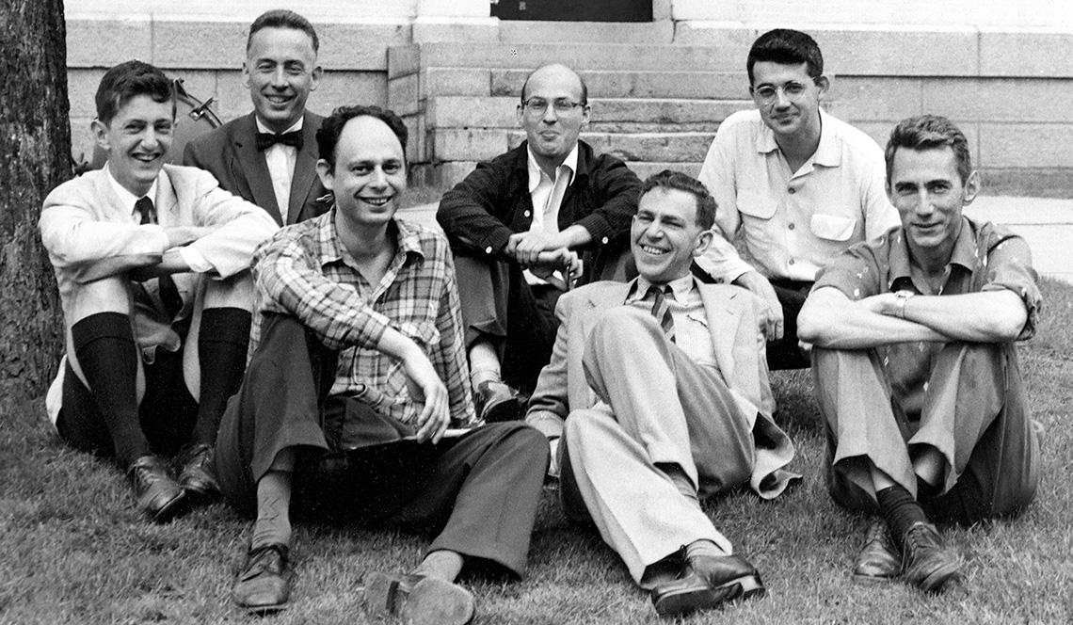
The Dartmouth Summer Research Project - 1956
A group of prominent academics studying AI got together in the summer of 1956.
The goal was to develop “Human Level Intelligence” over the summer.
John McCarthy coined the term AI here
Definition of AI “computer programs that can solve problems and achieve goals in the world as well as humans”

Slide 14
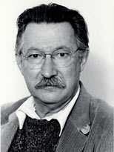
ELIZA (1966)
A very early example of a chatbot developed in 1966
Developed by Joseph Weizenbaum
Meant to imitate a psychotherapists
Uses bases syntactic parsing to rephrase user input.
Users quickly became very attached.
Some users demanded Weizenbaum leave the room so they could “talk to ELIZA”

Slide 15
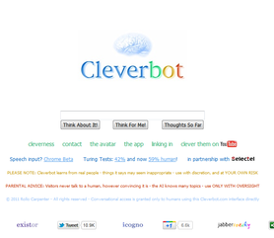
Cleverbot (1988 - 2008)
Started Development in 1988, continuously improved for 20 years
Uses a method of encoding a prompt numerically, then finds a similar prompt and response to answer with.
Can produce weird results

